Slide 1
Benha University
Faculty of Science
Department of Zoology
Circulatory System
إعـداد
أ.م د. دعاء صبرى إبراهيم
أستاذ مساعد بقسم علم الحيوان

Slide 2
The circulatory system
cardiovascular system
heart
blood vessels
lymphatic system
The circulatory system

Slide 3
The heart
The heart is a four-chambered double pump. It's pumping action creates the pressure head needed to push blood through the vessels to the lungs and body cells. At rest, the heart of an adult pumps about 5 liters of blood per minute. At this rate, it takes about 1 minute for blood to be circulated to the most distal extremity and back to the heart.

Slide 4
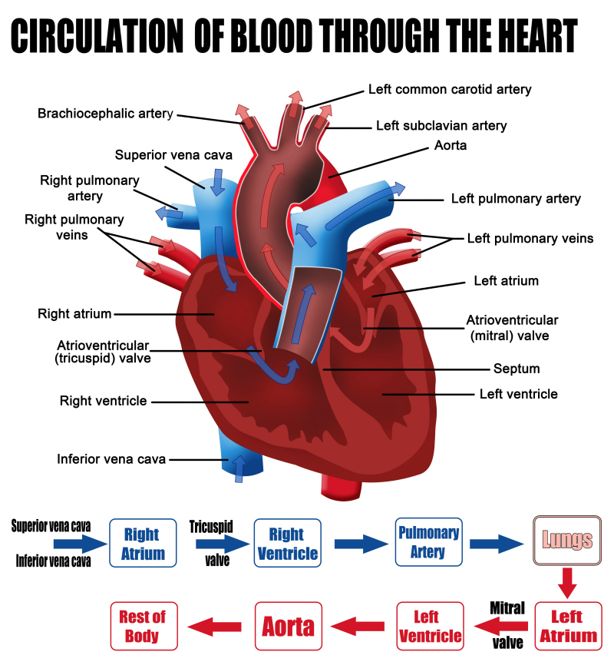

Slide 5
Blood vessels
Blood vessels
Arteries
carry blood away from the heart
Venules
the smallest of the veins
Capillaries
the thinnest and most numerous of the blood vessels
Veins
return blood to the heart
Arterioles
The smallest of the arteries

Slide 6
Blood plasma (the fluid portion of the blood) passes from arterioles into capillaries, then the hydrostatic pressure of the blood forces some of this fluid out of the capillary walls. Fluid derived from plasma that passes out of capillary walls into the surrounding tissues is called tissue fluid, or interstitial fluid. Some of this fluid returns directly to capillaries then to venules, and some enter into lymphatic vessels located in the connective tissues around the blood vessels. Fluid in lymphatic vessels is called lymph

Slide 7
Functions of blood
It transports oxygen from lungs to tissues.
It transports carbon dioxide from tissues to lungs.
It carries nutrients as glucose and amino acids.
It transports wastes of metabolism and toxic substances to kidney.
It transports some enzymes and hormones to affected organs.
It helps in regulation of body temperature.
Leukocytes protect the body against bacteria and harmful microorganisms.

Slide 8
The circulatory system
cardiovascular system
lymphatic system
The circulatory system
lymphoid tissues
lymphatic vessels
spleen, thymus, tonsils, and lymph nodes.
Lymphatic capillaries
The smallest vessels of the lymphatic system

Slide 9
Lymph
thoracic duct
left subclavian veins
right subclavian veins
the right lymphatic duct
lymph ducts
lymphatic capillaries
Veins
Before the lymph is returned to the cardiovascular system, it is filtered through lymph nodes

Slide 10
مع تمنياتى لكم بالنجاح والتوفيق
لمزيد من المعلومات
http://www.bu.edu.eg/staff/doaamohamed7-courses

